Slide 1
1
2
Summary
Raw Data eg log files
Preprocessing App usage, screen time, consistency
More Data
eg. Location
Indicators
(of depression/
stress)
Prediction
ML models
4
3
More Predictions
Maybe Like a personality chart
Notes:
Step 3 – long term step 4 – short term
Collect data from people [at least 10]

Slide 2
Next Steps
→ Track the variables and features that were studied in previous works.
→ Research about surveys that can be used to study people and their data better. → Collect some data.

Slide 3
Features study
→ Curated a data of variables studied in 4 research papers.
Paper 1: Beames, J. R., Han, J., Shvetcov, A., Zheng, W. Y., Slade, A., Dabash, O., Rosenberg, J., O'Dea, B., Kasturi, S., Hoon, L., Whitton, A. E., Christensen, H., & Newby, J. M. (2024). Use of smartphone sensor data in detecting and predicting depression and anxiety in young people (12–25 years): A scoping review. Heliyon, 10(15), e35472. https://doi.org/10.1016/j.heliyon.2024.e35472
Paper 2: Opoku Asare K, Terhorst Y, Vega J, Peltonen E, Lagerspetz E, Ferreira D
Predicting Depression From Smartphone Behavioral Markers Using Machine Learning Methods, Hyperparameter Optimization, and Feature Importance Analysis: Exploratory Study
JMIR Mhealth Uhealth 2021;9(7):e26540
URL: https://mhealth.jmir.org/2021/7/e26540
DOI: 10.2196/26540

Slide 4
Features study
→ Curated a data of variables studied in 4 research papers.
Paper 3: De Angel, V., Lewis, S., White, K., Oetzmann, C., Leightley, D., Oprea, E., Lavelle, G., Matcham, F., Pace, A., Mohr, D. C., Dobson, R., & Hotopf, M. (2022). Digital health tools for the passive monitoring of depression: A systematic review of methods. Npj Digital Medicine, 5(1), 1-14. https://doi.org/10.1038/s41746-021-00548-8
Paper 4: Melcher J, Hays R, Torous J
Digital phenotyping for mental health of college students: a clinical review
BMJ Ment Health 2020;23:161-166.
https://mentalhealth.bmj.com/content/23/4/161
Some Points to remember :
Some of these studies are quite old, and the behavioral patterns of people have shifted in general from then, so directly picking up observations and conclusions might not be appropriate.
Largely focused on data of the US and other western countries.

Slide 5
Features study
Curated a data of variables and features studied in 4 research papers.
In general, several low level and high level variables were studied.
Low level features refer to raw data from mobile phones and wearable devices, and the most common features and their categorization are:
Location (GPS, Wi-Fi association)
Accelerometer (steps, moving speed)
Screen Activity (screen lock/unlock, screen time, regularity)
Call/text/social media activity (call logs, SMS logs, Social media apps usage and frequency)
Internet Connectivity
App Usage (Types of apps, time spent and frequency)
Others (microphone, Bluetooth)

Slide 6
Features study
Curated a data of variables and features studied in 4 research papers.
In general, several low level and high level variables were studied.
High level features refer to behavioral markers which are derived by studying the low-level features :
Sleep (duration, regularity, quality)
Activity levels (physical activities, steps)
Circadian Rhythm (daily routine)
Sociability (frequency and duration of calls and messages, social media apps usage)
Location/mobility (unique locations visited, distance covered)
Phone Usage (screen time, app usage, phone checks per day)
Mood status (anxiety severity and frequency, depression symptoms)
Combination of features is very commonly used and turns out to be quite effective.
Notes:
Create an excel to understand the dependent variables f(x) of the high level variables as well what feature hasn’t been studied properly, and we can study based on the data that we have in depth study of feautes

Slide 7
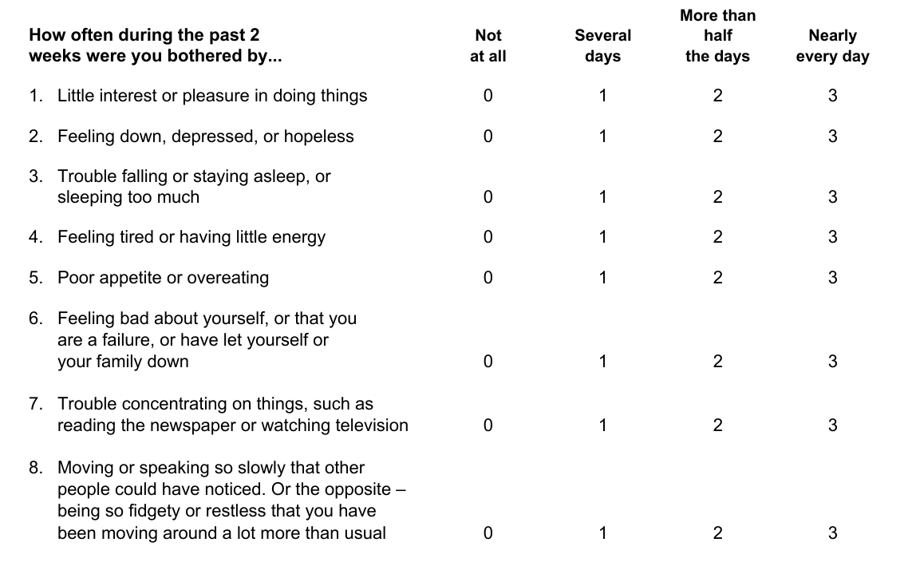
Mental health assessment surveys
PHQ-8 is the most reliable survey for depressive symptoms.

Slide 8
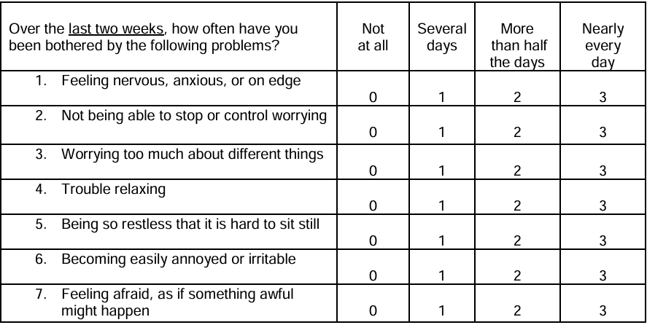
Mental health assessment surveys
GAD-7 is the most reliable survey for anxiety symptoms.

Slide 9
Predictions & Finding correlations
The aim to analyse how can behavioural markers correlate with the scores on the surveys, indicating patterns in behaviour that can indicate depression or anxiety symptoms.
Some results from the studied papers are:
Sleep: Lower sleep efficiency or quality (including increased sleep fragmentation) is associated with higher depression scores.
Physical Activity: Lower levels of physical activity are associated with higher depression.
Location: Increased time spent at home is associated with higher depression scores.
Sociability: Fewer calls/texts in public places are associated with increased anxiety.
Phone Use: Averaged number of screen unlocks is negatively associated with depression
Combination of features often turn out better indicators of depression and/or anxiety symptoms.

Slide 10
Steps ahead :
Read more papers ?
Check if these surveys are relevant for our audience. Find more relevant surveys and questionnaires.
Collect first hand data.
Check out what data we can get, and how can it lead to novel information and research.
→ Instabilities in routines are common in student lives. Find ways that can work for us.

